Slide 1
Example
Exam Prep

Slide 2
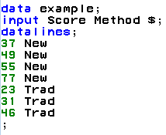
Exam Preparation
IBM gives each employee in the marketing department technical training.
Based on further testing, it appears the traditional training method isn’t effective.
Hence, a new training method is developed.
Below are the test scores of four individuals who just finished the “New Method” and the last three test scores from employees trained via the “Traditional Method” course.
Is there evidence to suggest that the “New Method” increases test scores?
New Method | Traditional Method
37 | 23
49 | 31
55 | 46
77

Slide 3
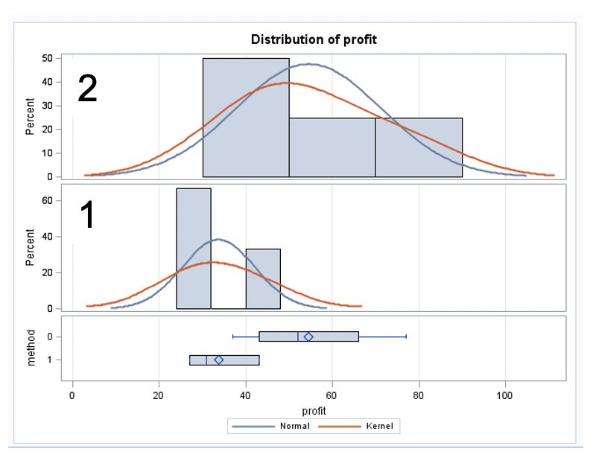
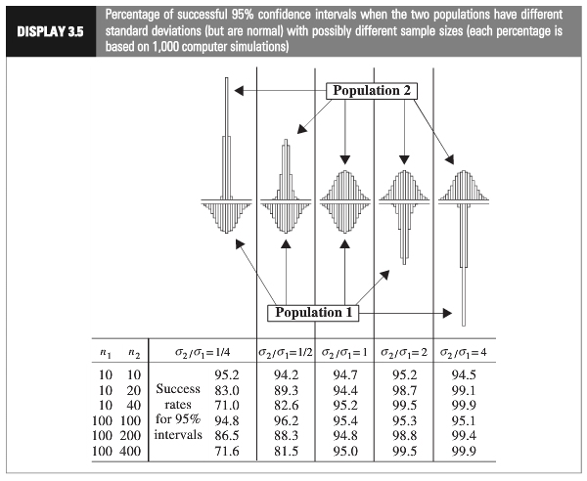
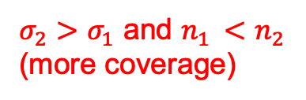
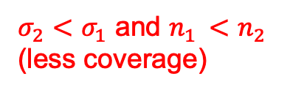
Which situation does it appear we are in?
$σ_{2}<σ_{1}$ and $n_{1 }<$ $n_{2 }$
(less coverage)
$σ_{2}>σ_{1}$ and $n_{1 }<$ $n_{2 }$
(more coverage)
Using a t-test could have low power.
A permutation test does not make these assumptions and approximates the pvalue directly through building he null distribution!
Notes:
Worst case: the variance from the larger group is smaller than the variance from smaller group:

Slide 5
Comparison with t-Test

Slide 6
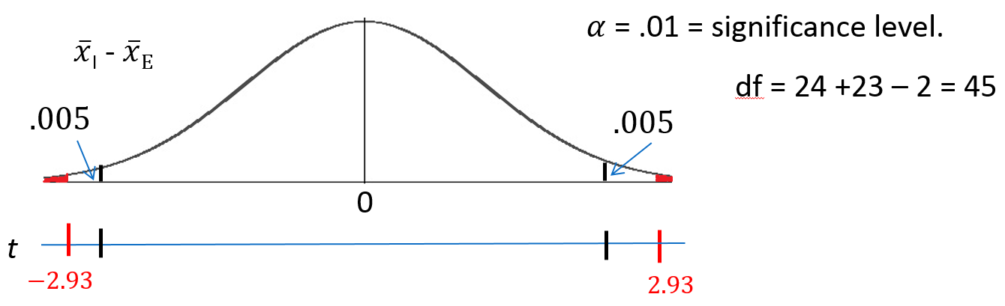
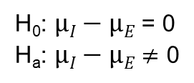
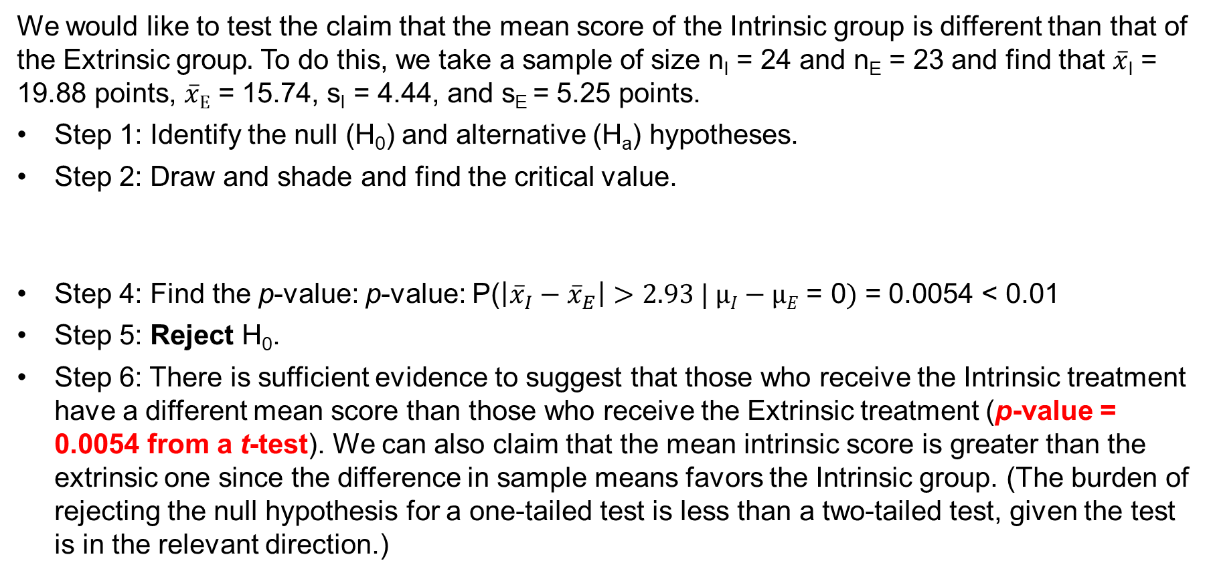
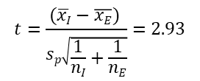
Let’s Formalize this Test into Six Steps!
We would like to test the claim that the mean score of the Intrinsic group is different than that of the Extrinsic group$.$ To do this, we take a sample of size n_{I} = 24 and n_{E} = 23 and find that $\overline{x}$_{I} = 19.88 points, $\overline{x}E$ = 15.74, s_{I} = 4.44, and s_{E} = 5.25 points.
Step 1: Identify the null (H₀) and alternative (H_{a}) hypotheses.
Step 2: Draw and shade and find the critical value.
Step 4: Find the p-value: p-value: P($\left|{\overline{x}}_{I}−{\overline{x}}_{E}\right|>2.93 | µI−µE\text{ = 0})$ = 0.0054 < 0.01
Step 5: Reject H₀.
Step 6: There is sufficient evidence to suggest that those who receive the Intrinsic treatment have a different mean score than those who receive the Extrinsic treatment (p-value = 0.0054 from a t-test). We can also claim that the mean intrinsic score is greater than the extrinsic one since the difference in sample means favors the Intrinsic group. (The burden of rejecting the null hypothesis for a one-tailed test is less than a two-tailed test, given the test is in the relevant direction.)
H₀: $µI−µE$ = 0
H_{a}: $µI−µE$ $≠$ 0
Step 3: Find the test statistic (the t value for the data).
$$t=\frac{(\overline{xI}−\overline{xE}) }{sp\sqrt{\frac{1}{nI}+\frac{1}{nE}}}=2.93$$

Slide 7
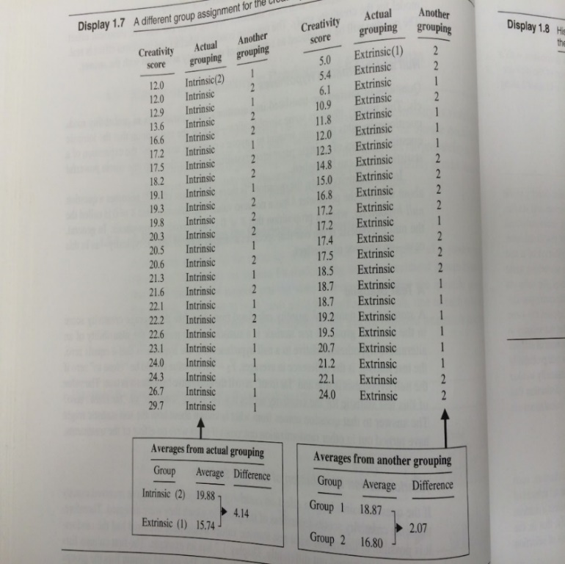
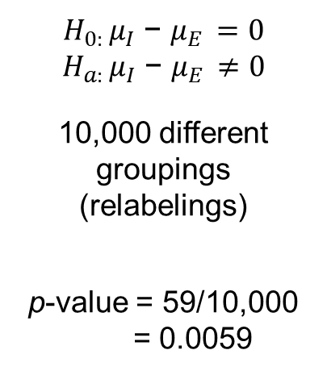
Motivation and Creativity: Conclusion
$H_{0: }μ_{I}$ − $μ_{E }=0$
$H_{a: }μ_{I}$ − $μ_{E }≠0$
10,000 different groupings (relabelings)
p-value = 59/10,000 = 0.0059
-4.14
4.14
Conclusion (client facing): There is strong evidence to suggest that the mean score of those who would take the “Intrinsic” method is different from the mean score of those who would take the “Extrinsic” treatment (p-value = .0059 from a permutation test).

Slide 9
Inference for the Variance

Slide 10
Need Content

Slide 12
Example
O-ring Study

Slide 13
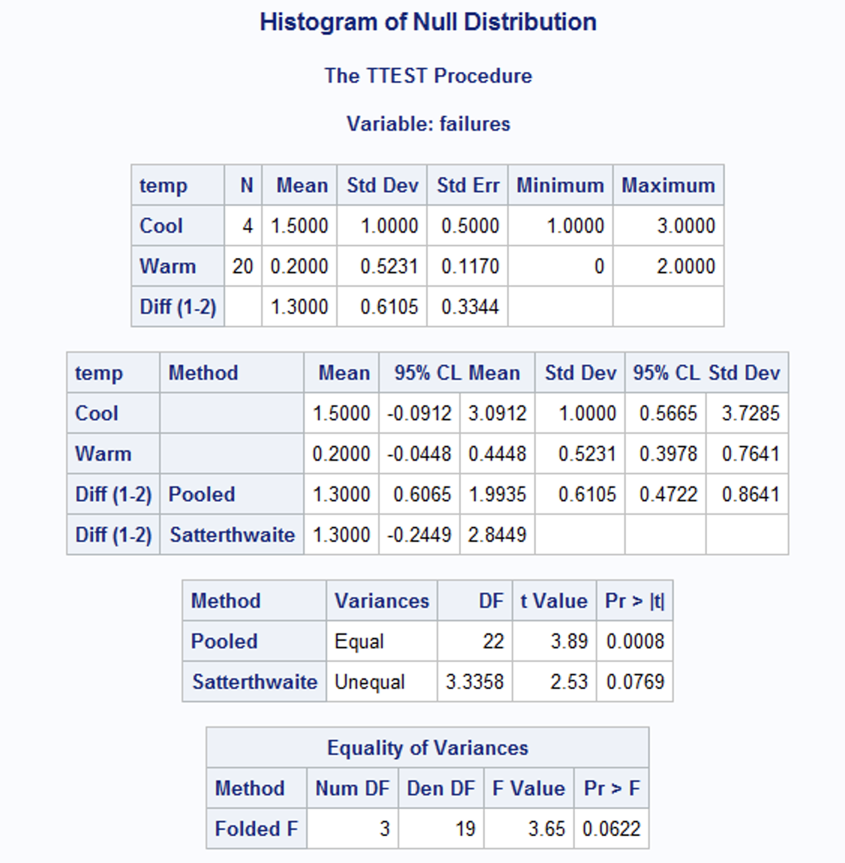
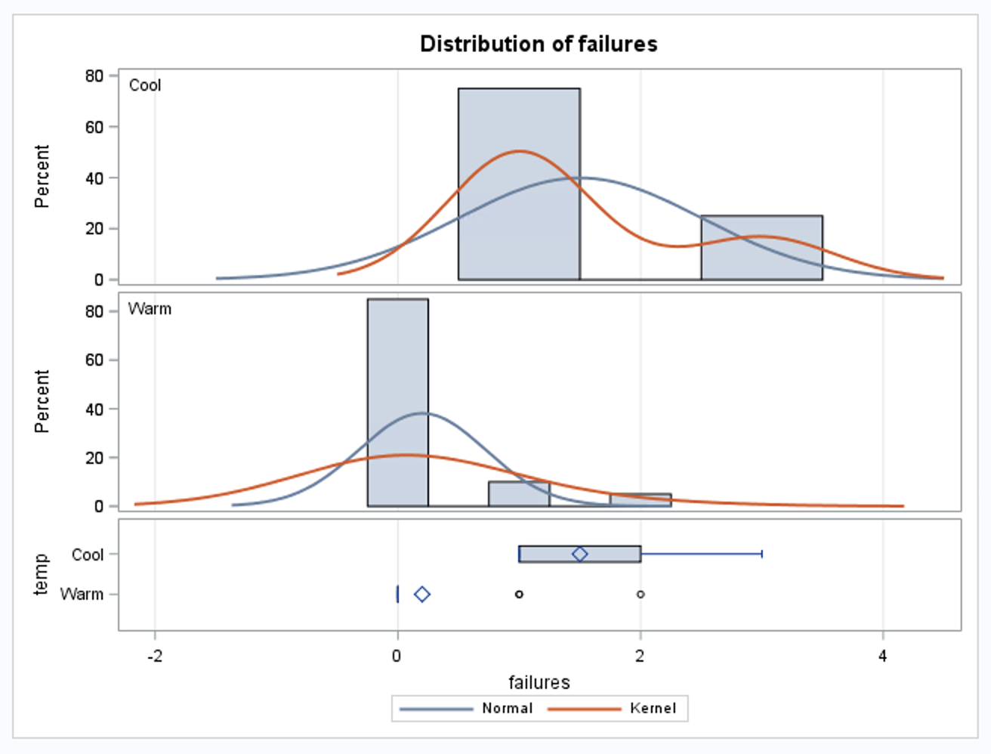
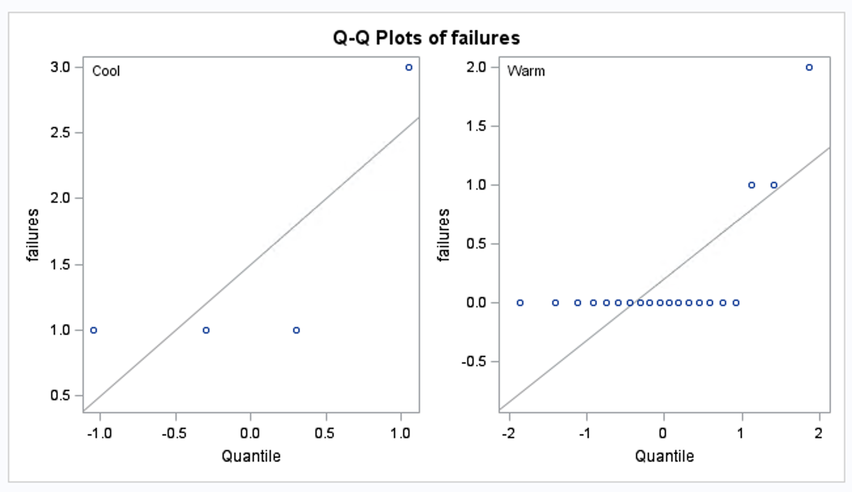
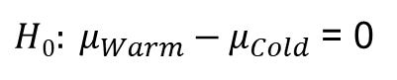
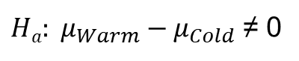
O-ring Study: t-Test?
data Oring;
input failures temp $;
datalines;
1 Cool
1 Cool
1 Cool
3 Cool
0 Warm
0 Warm
0 Warm
0 Warm
0 Warm
0 Warm
0 Warm
0 Warm
0 Warm
0 Warm
0 Warm
0 Warm
0 Warm
0 Warm
0 Warm
0 Warm
0 Warm
1 Warm
1 Warm
2 Warm
;
proc ttest data = Oring;
class temp;
var failures;
run;
$H0: μ_{Warm}−μ_{Cold}$ = 0
$Ha: μ_{Warm}−μ_{Cold}$ ≠ 0

Slide 14
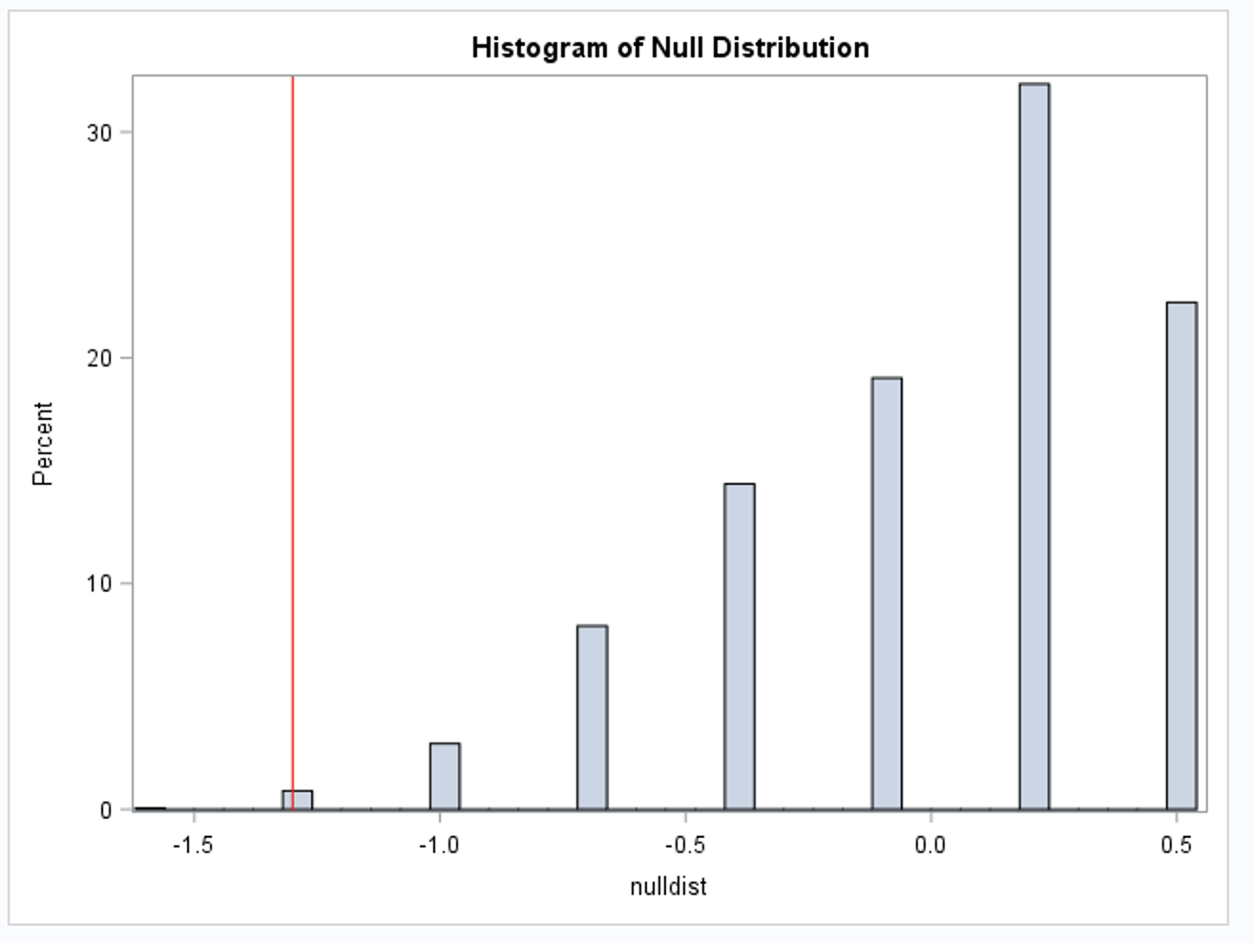
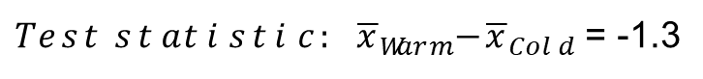
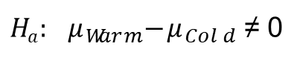
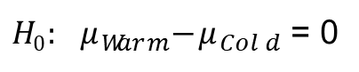
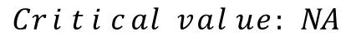
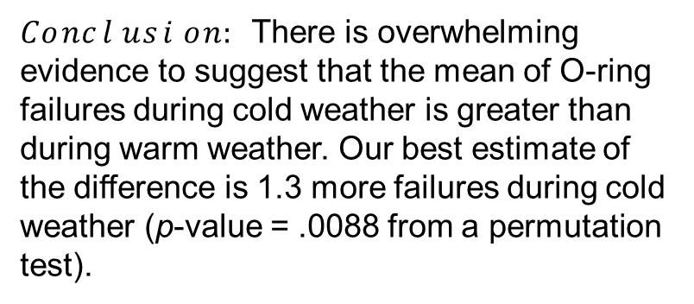
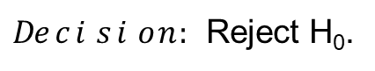
O-ring Study
$H0: μ_{Warm}−μ_{Cold}$ = 0
$Ha: μ_{Warm}−μ_{Cold}$ ≠ 0
$$Critical value:NA$$
$Test statistic: {\overline{x}}_{Warm}−{\overline{x}}_{Cold}$ = -1.3
p-Value: .0088
$Decision:$Reject H₀.
$Conclusion:$ There is overwhelming evidence to suggest that the mean of O-ring failures during cold weather is greater than during warm weather. Our best estimate of the difference is 1.3 more failures during cold weather (p-value = .0088 from a permutation test).

Slide 15
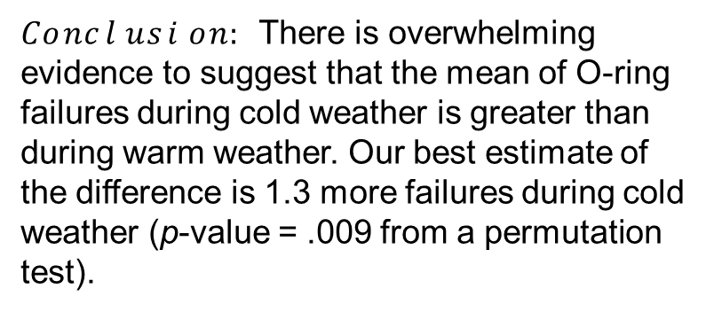
O-ring Study (cont.)
$H0: μ_{Warm}−μ_{Cold}$ = 0
$Ha: μ_{Warm}−μ_{Cold}$ ≠ 0
$$Critical value:NA$$
$Test statistic: {\overline{x}}_{Warm}−{\overline{x}}_{Cold}$ = -1.3
p-Value: .009
$Decision:$Reject H₀.
$Conclusion:$ There is overwhelming evidence to suggest that the mean of O-ring failures during cold weather is greater than during warm weather. Our best estimate of the difference is 1.3 more failures during cold weather (p-value = .009 from a permutation test).

Slide 17
The “Exact” Test

Slide 18
Exam Prep
IBM gives each employee in the marketing department technical training.
Based on further testing, it appears the traditional training method isn’t effective.
Hence, a new training method is developed.
Below are the test scores of four individuals who just finished the “New Method” and the last three test scores from employees trained via the “Traditional Method” course.
Is there evidence to suggest that the “New Method” increases test scores?
New Method | Traditional Method
37 | 23
49 | 31
55 | 46
77

Slide 19
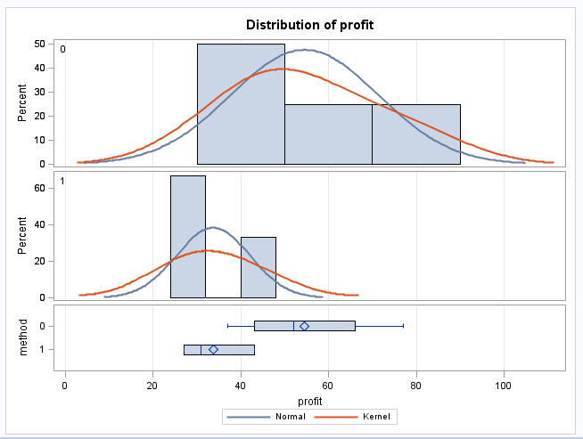
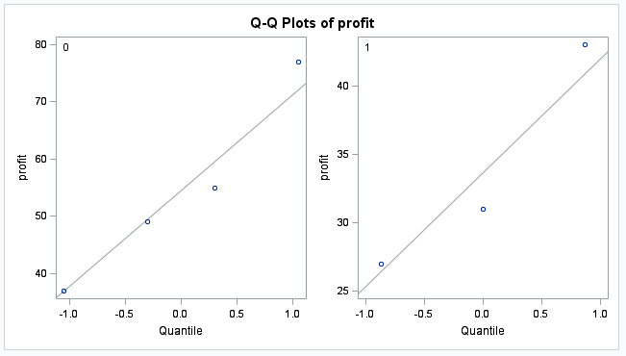
Examining the t Tools Assumptions
2
2
1
1
Since the standard deviations appear (visual check) to be different and the sample sizes are both different and exceptionally small, the t-test was not deemed appropriate and the nonparametric rank sum test was performed.

Slide 20
Which situation does it appear we are in?
$σ_{2}<σ_{1}$ and $n_{1 }<$ $n_{2 }$
(less coverage)
$σ_{2}>σ_{1}$ and $n_{1 }<$ $n_{2 }$
(more coverage)
Using a t-test could have low power.
A permutation test does not make these assumptions and approximates the pvalue directly through building he null distribution!
Notes:
Worst case: the variance from the larger group is smaller than the variance from smaller group:

Slide 21
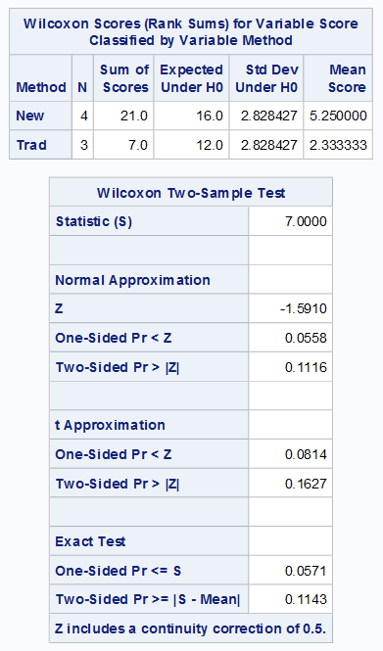
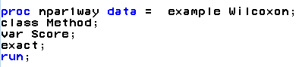
Permutation Test (Exact p-Value)
Exact p-values
In R:
wilcox.test(Score~Method, alternative = “two-sided”)
#OR
wilcox.test(Score~Method, exact = TRUE, alternative = “two-sided”)

Slide 22
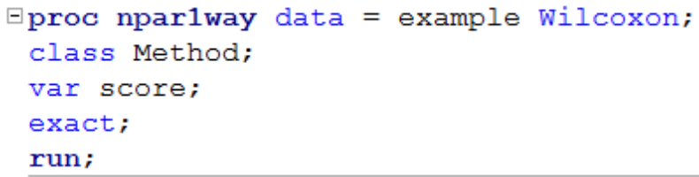
Rank Sum Test (Wilcoxon)
H₀: The median of New Method scores = The median of the Traditional Method scores
H₁: The median of New Method scores > The median of the Traditional Method scores
There is sufficient evidence at the alpha = 0.1 level of significance (p-value = .0571 for the exact test) to suggest that the median of IBM employees that were given the New Method is greater than the median of those who took the test having had the Traditional Method of instruction.

Slide 24
The Normal Approximation

Slide 25
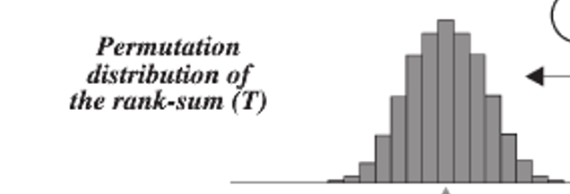
The Sampling Distribution of …
The rank-sum statistic!
Rank-sum test statistic (sum of ranks of one group) is approximately normally distributed!

Slide 26
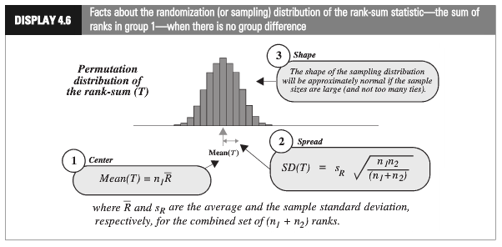
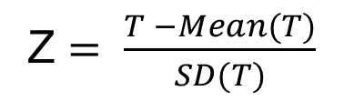
Rank-Sum Test: Normal Approximation
Z $= \frac{T −Mean(T)}{SD(T)}$

Slide 27
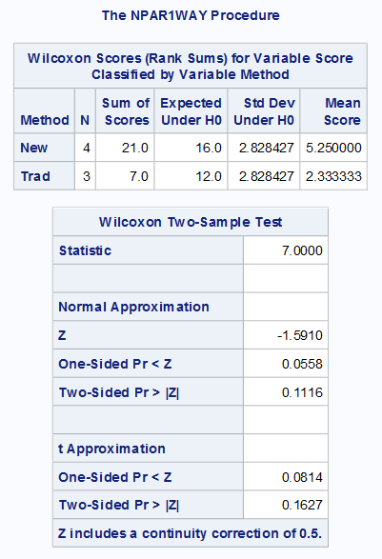
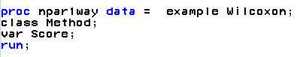
Rank-Sum Test: Normal Approximation (cont.)
Common interpretation
H₀: The median of New Method scores = The median of the Traditional Method scores
H₁: The median of New Method scores > The median of the Traditional Method scores
There is mild evidence (alpha = 0.1) to suggest that the median of scores from the “New Method” is greater than the median of the “Traditional Method” (normal approximation to rank-sum test p-value = 0.0558).

Slide 29
Continuity Correction

Slide 30
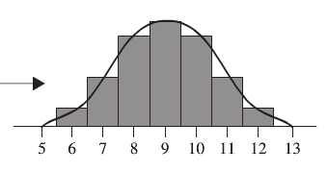
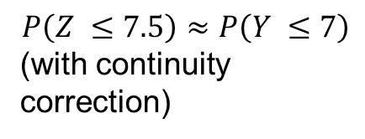
Continuity Correction: Main Idea
$P\left(Z ≤7\right)$ for a continuous Z is much smaller than $P\left(Y ≤7\right)$ for integer Y, (no continuity correction (CC)).
$$P\left(Z ≤7.5\right)≈P\left(Y ≤7\right)$$
(with continuity correction)
The exact probability calculation for $P(Y ≤7)$ when Y is an integer

Slide 31
Rank-Sum Test: Normal Approximation
Common interpretation
H₀: The median of New Method scores = The median of the Traditional Method scores
H₁: The median of New Method scores > The median of the Traditional Method scores
There is mild evidence (alpha = 0.1) to suggest that the median of scores from the “New Method” is greater than the median of the “Traditional Method” (normal approximation to rank-sum test p-value = 0.0558).

Slide 33
The Rank-Sum Test in R
In Live Session

Slide 34
Rank-Sum Test: R Code
library(dplyr)
scoreDF = data.frame(Score = c(37,49,55,77,23,31,46), Treatment = c("New","New","New","New","Traditional","Traditional","Traditional"))
scoreDF %>% group_by(Treatment) %>% summarise(
count = n(),
median = median(Score, na.rm = TRUE),
IQR = IQR(Score, na.rm = TRUE)
)
scoreNew = filter(scoreDF,Treatment == "New")
scoreTrad = filter(scoreDF,Treatment == "Traditional")
wilcox.test(Failures ~ Temp, data = Oring, exact = TRUE) # Note … ignores Exact in in formula mode
wilcox.test(Failures ~ Temp, data = Oring, exact = FALSE)
wilcox.test(scoreNew$Score,scoreTrad$Score, exact = TRUE)
wilcox.test(scoreNew$Score,scoreTrad$Score, exact = TRUE, alternative = "g")
wilcox.test(scoreNew$Score,scoreTrad$Score, exact = FALSE, alternative = "g")
wilcox.test(scoreNew$Score,scoreTrad$Score, exact = FALSE, alternative = "g")
To compare with SAS
http://www.sthda.com/english/wiki/unpaired-two-samples-wilcoxon-test-in-r

Slide 36
Example
Cognitive Load Theory in Teaching

Slide 37
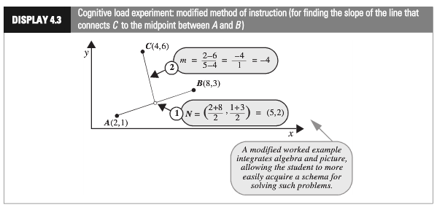
Cognitive Load Experiment, Part I
Researchers compared the effectiveness of conventional textbook examples to modified ones.
They selected 28 ninth-year students who had no previous exposure to coordinate geometry.
The students were randomly assigned to one of two self-study instructional groups, using conventional and modified instructional materials.
After instruction, they were given a test and the time to complete one of the problems was recorded.
Is there sufficient evidence to suggest that the cognitive load theory (modified instruction) shortened response times?

Slide 38
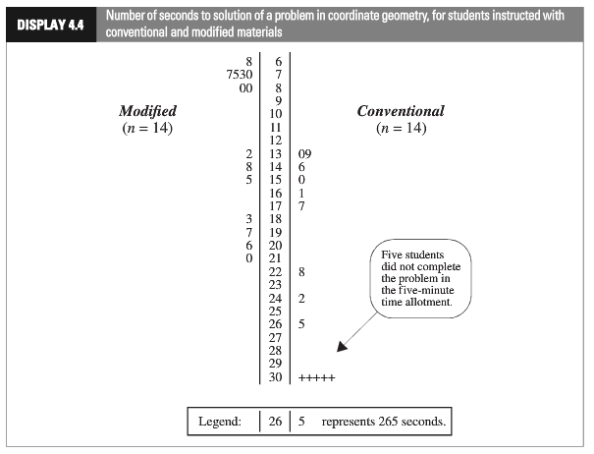
Cognitive Load Experiment, Part II
(Censored data)

Slide 39
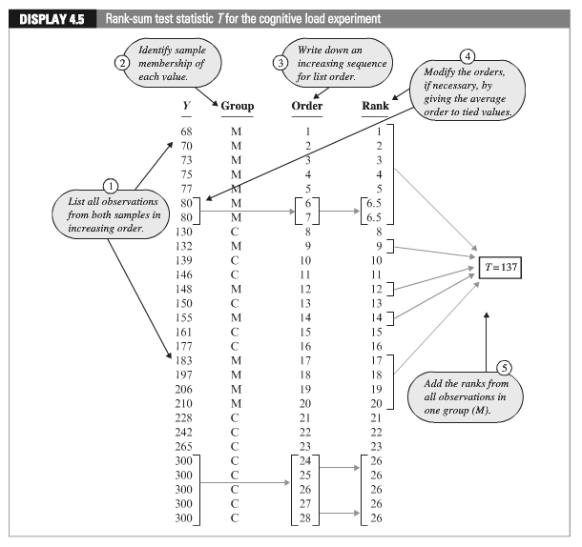
Cognitive Load Experiment, Part III

Slide 40
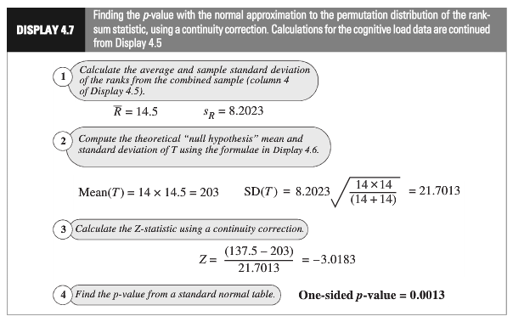
Cognitive Load Experiment: Normal Approximation
(Continuity correction)
Statistical conclusion: The data provide convincing evidence that a student could solve the problem more quickly after the “modiﬁed” rather than the “conventional” method (one-sided, normal approximation with CC p-value = 0.0013, from the rank-sum test).

Slide 41
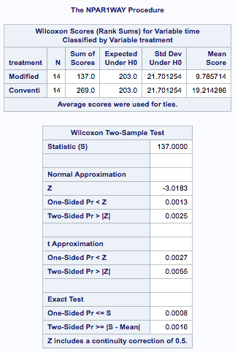
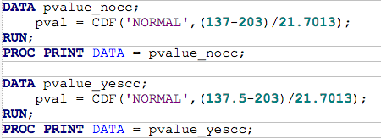
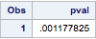
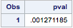
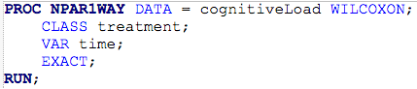
Cognitive Load Experiment: Using SAS

Slide 42
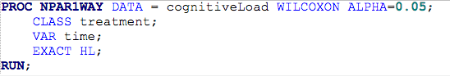
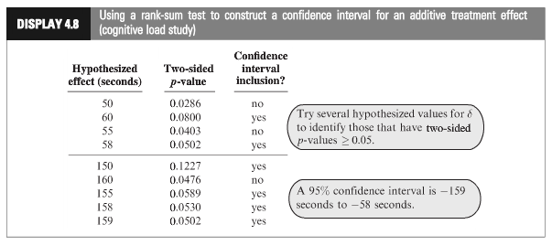
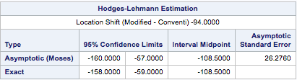
Cognitive Load Experiment
Statistical conclusion (cont.): We are 95% confident that the median of the times of the modified group is between 59 and 158 seconds less than that of the conventional group. Our best estimate is that the modified group is 108 seconds faster.

Slide 43
Cognitive Load Experiment (All Together)
H₀:Median of Modified and Conventional scores are equal.
H_{a}: Median of Modified scores is less than that of Conventional.
Critical value (left-sided): −1.645 (alpha = .05)
Test statistic: t-stat = −3.0183
p-Value (left-sided) = .0013
Reject H₀.
Statistical conclusion (cont.): The data provide convincing evidence that a student could solve the problem more quickly after the “modiﬁed” rather than the “conventional” method (one-sided, normal approximation with CC p-value = 0.0013, from the rank-sum test). We are 95% confident that the median of the times of the modified group is between 59 and 158 seconds less than that of the conventional group. Our best estimate is that the median of the modified group is 108 seconds smaller.

Slide 45
Example
Sign and Sign Rank Test in SAS

Slide 46
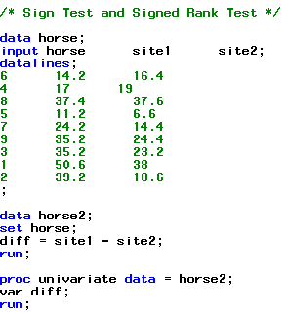
Example: Nerve Data
horse | site1 | site2
6 | 14.2 | 16.4
4 | 17 | 19
8 | 37.4 | 37.6
5 | 11.2 | 6.6
7 | 24.2 | 14.4
9 | 35.2 | 24.4
3 | 35.2 | 23.2
1 | 50.6 | 38
2 | 39.2 | 18.6
For each of the nine horses, a veterinary anatomist measured the density of nerve cells at specified sites in the intestine.

Slide 47
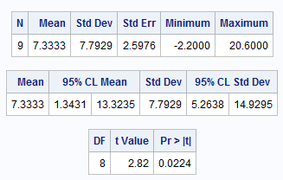


Using the Paired t-Test
The sample size is rather small, hence the normality assumption is suspect.

Slide 48

The Hypothesis Test
The hypotheses will be in terms of medians instead of means.
$H_{0}$: The median difference in nerve cell count between “site 1” and “site 2” is zero.
The alternative hypotheses
$H_{a}$: The median difference in nerve cell count between “site 1” and “site 2” is not zero.
$H_{a}$: The median difference in nerve cell count between “site 1” and “site 2” is greater than zero.
(Two-sided)
(One-sided)

Slide 49



Sign Test: Horse Data
$H_{a}$: The median difference in nerve cell count between “site 1” and “site 2” is > 0.
$$z= \frac{K−.5 −n/2}{\sqrt{n/4}}$$
horse | site1 | site2 | diff | Sign
8 | 37.4 | 37.6 | -0.2 | -
4 | 17 | 19 | -2 | -
6 | 14.2 | 16.4 | -2.2 | -
5 | 11.2 | 6.6 | 4.6 | +
7 | 24.2 | 14.4 | 9.8 | +
9 | 35.2 | 24.4 | 10.8 | +
3 | 35.2 | 23.2 | 12 | +
1 | 50.6 | 38 | 12.6 | +
2 | 39.2 | 18.6 | 20.6 | +
$$= \frac{6− .5 −9/2}{\sqrt{9/4}}=.6666$$
K = 6
$$P\left(Z>.6666\right)=0.2527$$
(One-sided, CC p-value)

Slide 50

Test and Conclusion
$H_{0}$: The median difference in nerve cell count between “site 1” and “site 2” is zero.
$H_{a}$: The median difference in nerve cell count between “site 1” and “site 2” is positive.
Critical value (right-sided): z_{0.05} = 1.645
p-value (one-sided) = .2527
t statistic: t_{stat} = 0.666
Fail to reject H₀
Statistical conclusion: There is not enough evidence that the median difference of nerve density between site 1 and site 2 is different from 0. (Wilcoxon sign test one-sided p-value of 0.2527). In other words there is not enough evidence to suggest the median density of nerve cells is different at sites 1 and 2.

Slide 51



Signed Rank Test: Horse Data
$$z= \frac{S −Mean(S)}{SD(S)}$$
horse | site1 | site2 | abs(diff) | Sign | rank
8 | 37.4 | 37.6 | 0.2 | - | 1
4 | 17 | 19 | 2 | - | 2
6 | 14.2 | 16.4 | 2.2 | - | 3
5 | 11.2 | 6.6 | 4.6 | + | 4
7 | 24.2 | 14.4 | 9.8 | + | 5
9 | 35.2 | 24.4 | 10.8 | + | 6
3 | 35.2 | 23.2 | 12 | + | 7
1 | 50.6 | 38 | 12.6 | + | 8
2 | 39.2 | 18.6 | 20.6 | + | 9
$$= \frac{39 − .5 −(9∗10)/4}{\sqrt{9∗10∗19/24}}=\text{1.}\text{89}$$
$$P\left(Z>1.89\right)=0.02938$$
S = 39
(One-sided, CC p-value)

Slide 52
Test, Conclusion, and Some Notes
$H_{0}$: The median difference in nerve cell count between “site 1” and “site 2” is zero.
$H_{a}$: The median difference in nerve cell count between “site 1” and “site 2” is positive.
Critical value (right-sided): z_{0.05} = 1.645
p-Value (one-sided) = 0.0294
t statistic: t_{stat} = 1.89
Reject H₀.
Statistical conclusion: There is strong evidence that the median difference of nerve density between site 1 and site 2 is greater than 0. (Wilcoxon sign rank test one-sided p-value of 0.0294). In other words there is strong evidence to suggest the median density of nerve cells is greater at site 1 than site 2.
Note
The signed-rank test has more power than the sign test (compare the p-values 0.254 vs. 0.0294).
Both tests make very few assumptions about the distributions.

Slide 53

Horse Data
Note: These are two-sided. Half of this is close to our calculated one-sided p-values from earlier.
Note: For n < 20 SAS uses the probabilities from the binomial distribution rather than the normal approximation. These are more accurate (exact) and we should use these when SAS is available.
R code: wilcox.test(horse$site1, horse$site2, paired = true)

Slide 55
Levene’s (Median) Test of Equal Spread (Homogeneity)

Slide 56
Exam Prep
IBM gives each employee in the marketing department technical training.
Based on further testing, it appears the traditional training method isn’t effective.
Hence, a new training method is developed.
Below are the test scores of four individuals who just finished the “New Method” and the last three test scores from employees trained via the “Traditional Method” course.
Is there evidence to suggest that the “New Method” increases test scores?
New Method | Traditional Method
37 | 23
49 | 31
55 | 46
77

Slide 57




Levene’s Test (Median)
H₀: Same Spread
H_{a}: Different Spread
But … proc t-test does not have Levene’s test!

Slide 58


Brown Forsythe Test (Median)
data exam;
input score type $;
datalines;
37 New
49 New
55 New
77 New
23 Traditional
31 Traditional
46 Traditional
;
proc glm data = exam;
class type;
model score = type;
means type / hovtest=bf;
run;
H₀: Equal spread
H_{a}: Different spread
data mediandiff;
input diff type$;
datalines;
15 New
3 New
3 New
25 New
8 Traditional
0 Traditional
15 Traditional
;
proc ttest data = mediandiff;
class type;
var diff;
run;
There is not enough evidence to suggest the spread is different in the exam scores of those who took the new training vs. the traditional training.

Slide 59



Levene’s Test (Mean)
data exam;
input score type $;
datalines;
37 New
49 New
55 New
77 New
23 Traditional
31 Traditional
46 Traditional
;
proc glm data = exam;
class type;
model score = type;
means type / hovtest=levene(type = abs);
run;
H₀: Equal spread
H_{a}: Different spread
data meandiff;
input diff type$;
datalines;
17.5 New
5.5 New
0.5 New
22.5 New
10.3333 Traditional
2.3333 Traditional
12.6666 Traditional
;
proc ttest data = meandiff;
class type;
var diff;
run;
There is not enough evidence to suggest the spread is different in the exam scores of those who took the new training vs. the traditional training.

